Slide 1
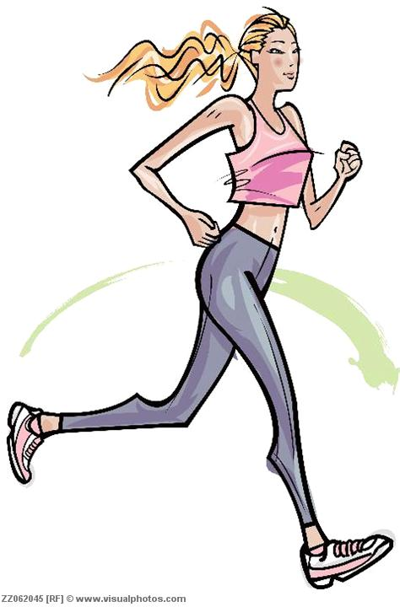
Human Activity Recognition using Smartphone
Submited By:(BATCH 6)
SAVARAM VENKATESWARA RAO(20KN1A05F1)
SHAIK JAANI(20KN1A05F6)
USHA KIRANMAI MANDALA(20KN1A05H6)

Slide 2
Outline
Introduction
Problem statement
Goals
Methods
Software and hardware requirements
Existing and proposed systems
Conclusions

Slide 3
PROBLEM STATEMENT
Using sensors to identify human activities such as walking, jogging, limping.
Human Activity Recognition (HAR) is the problem of identifying a physical activity carried out by an individual dependent on a trace of movement within a certain environment.

Slide 4
Introduction: Activity Recognition
Human Activity Recognition (HAR) aims to identify the actions carried out by a person given a set of observations of him/herself and the surrounding environment. Recognition can be accomplished by exploiting the information retrieved from various sources such as environmental or body-worn sensors.

Slide 5
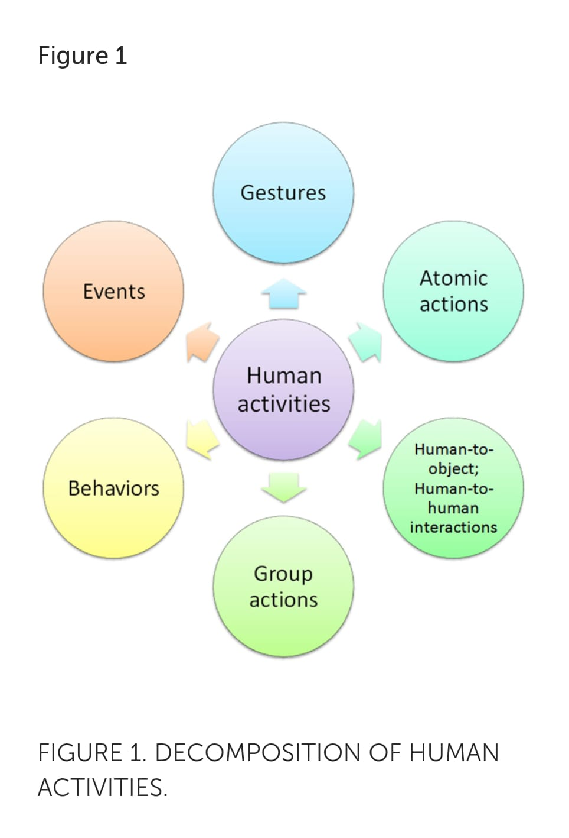

Slide 6
Motivation
  Human survey (study human daily activities)
  Medical care (diabetes, elderly, rehabilitation)
Sensors types
  Inertial sensors (accelerometer, gyroscope)
  Camera
  GPS
Smartphone is small and convenient to carry around and its computational resource is powerful enough for our purpose.

Slide 7
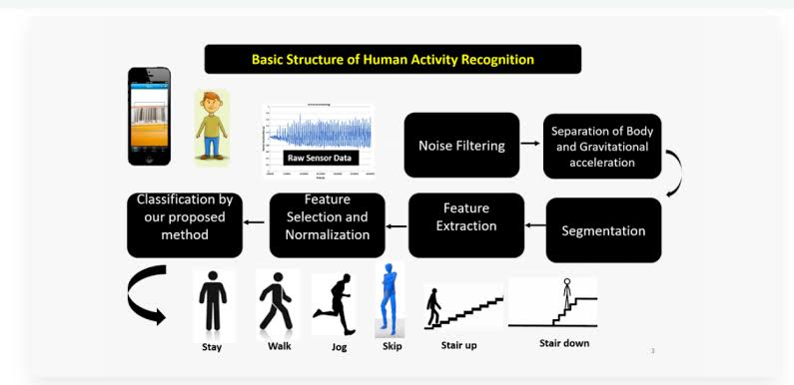

Slide 8
Goals
Design a simple, light weight, and accurate system that can learn human activity with minimum user interaction.
  Compare and find a model that best fit our system in terms of accuracy and efficiency.
  Reduce the labeling time and labor works using active learning.

Slide 9

Methods
Classification Techniques
  Quadratic
  K-Nearest Neighbors
  Support Vector Machines
  Artificial Neural Networks
Query Strategies based on Uncertainty
  Quadratic: Distance from discriminant curve
  KNN: Entropy
  SVM: Distance from the boundary
  ANN Discriminant function values

Slide 10
Software requirements
Sensor-based activity recognition seeks the profound high-level knowledge about human activities from multitudes of low-level sensor readings. Conventional pattern recognition approaches have made tremendous progress in the past years. However, those methods often heavily rely on heuristic hand-crafted feature extraction, which could hinder their generalization performance. Recently, the recent advancement of deep learning makes it possible to perform automatic high-level feature extraction thus achieves promising performance in many areas

Slide 11
hardware requirements
Here we use hard ware such as mobiles , CCTVs,computers,few chips etc
The most widely used hardware devises are watches and mobiles.

Slide 12
Existing system
The existing system was manual where a person had to sit in front of a monitor to monitor and guide human activities, it was hectic, time consuming and costlier system and was prone to human errors and negligence. Further some systems started using sensor data to recognize human activities but they were needed to be worn by the user which limited the scope of activity recognition in open environment in general.

Slide 13
Proposed System
Unlike the existing system, the proposed system takes input in the form of video and image to recognize the activity being performed in it. It is much faster and a cost effective solution. It uses deep learning to recognize the activities. This system can be used, incorporated or expanded further to cover a wide range of applications. Hence, it acts as a base system for various applications and tasks. Moreover, it can reduce the need of additional staff for entering data. Thereby, reducing the cost of the companies considerably.

Slide 14
CONCLUSION
In this project, we designed a smartphone-based recognition system that recognizes five human activities:walking, limping, jogging, going upstairs and going downstairs. The system collected time series signals using a built-in accelerometer, generated 31 features in both time and frequency domain, and then reduced the feature dimensionality to improve the performance.

